Slide 1
Mobile Robot, Midterm edition
By
Borys Dudariev
Piotr Balion

Slide 2
Introduction
This semester we decided to create a mobile robot for search and rescure operations, in this presentation we will show the progress we have made so far.

Slide 3
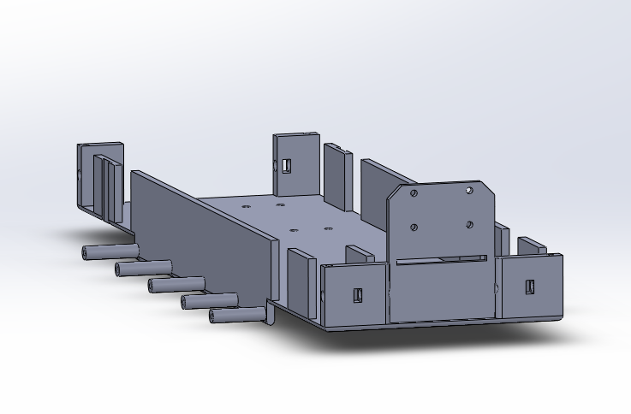
Part 1: Hull
The mechanical part of our robot consists of a hull and 2 sets of tracks
In this part we will show the features of the hull

Slide 4
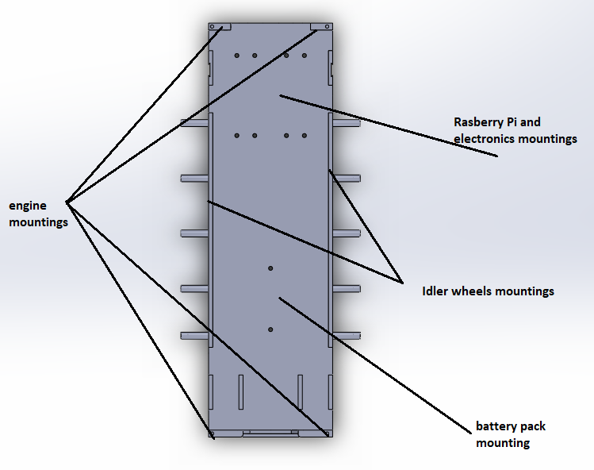
The hull consists of a 2 pieces. The main piece has mountings for electronics, up to 4 engines, a forward facing camera and 2 mountings for different sized Raspberry Pi’s.
The second piece is consists of a lid to cover the components

Slide 5
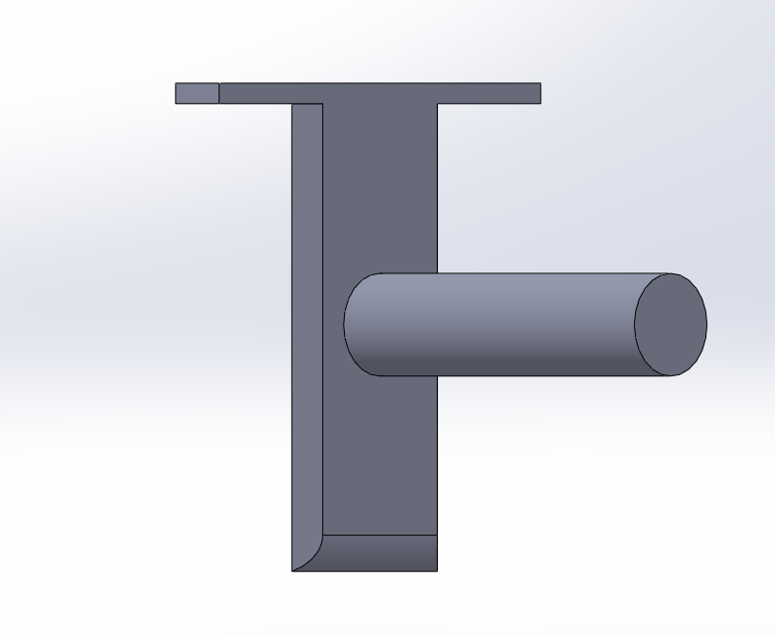
Additional hull features
The hull has the option to switch between a 2-engine drive and 4 engine drive
The possibility to use wheels instead of tracks, also in 2 and 4 engine modes
In order to switch modes, the user has to add/remove the 2 back engines and install/remove the additional axle.

Slide 6
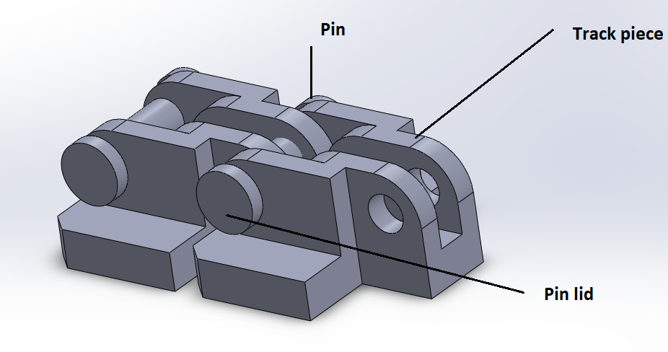
Part 2: Tracks
The average track consists of a single piece, with a pin going through it.
The pin is used to hold the tracks together and to be used a driving link by the sprocket wheel

Slide 7
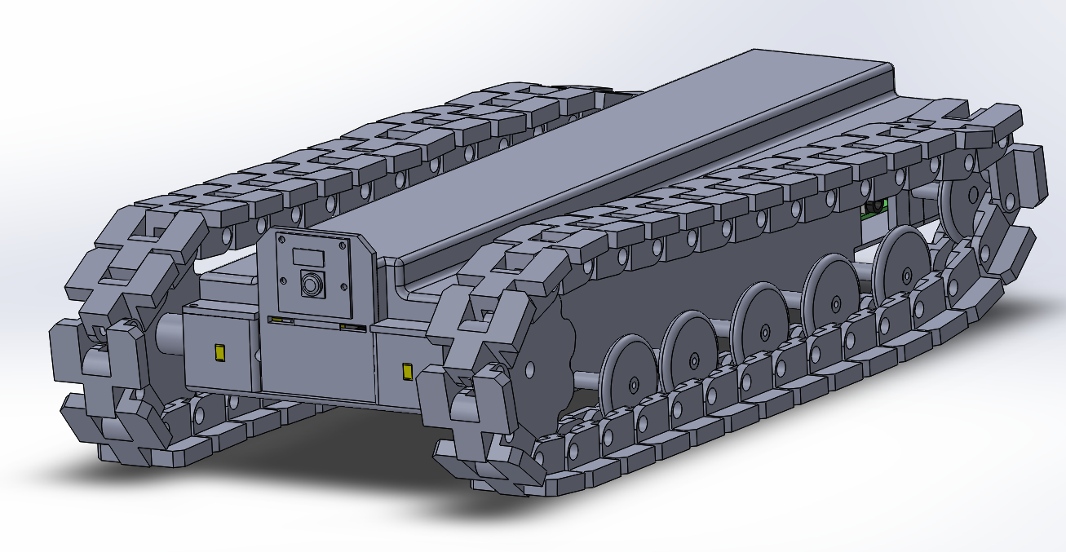
The Assembled Model

Slide 8
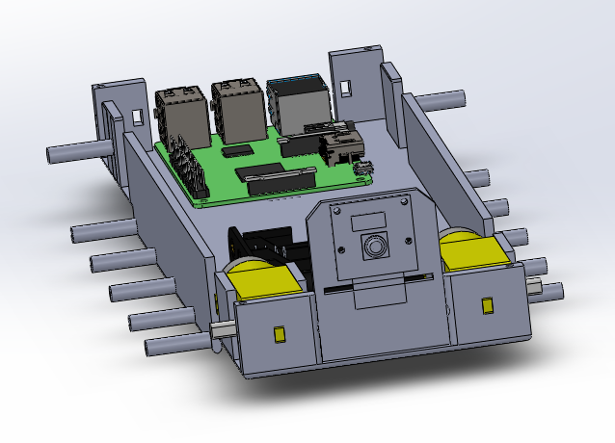
Part 3: Electric components
For this project the electric components consist of:
A Raspberry pi computer
2 or 4 DC motor engines
1-2 DC motor controllers
A camera
Power block
imu sensor
*Not all electronic components are represented in the picture

Slide 9
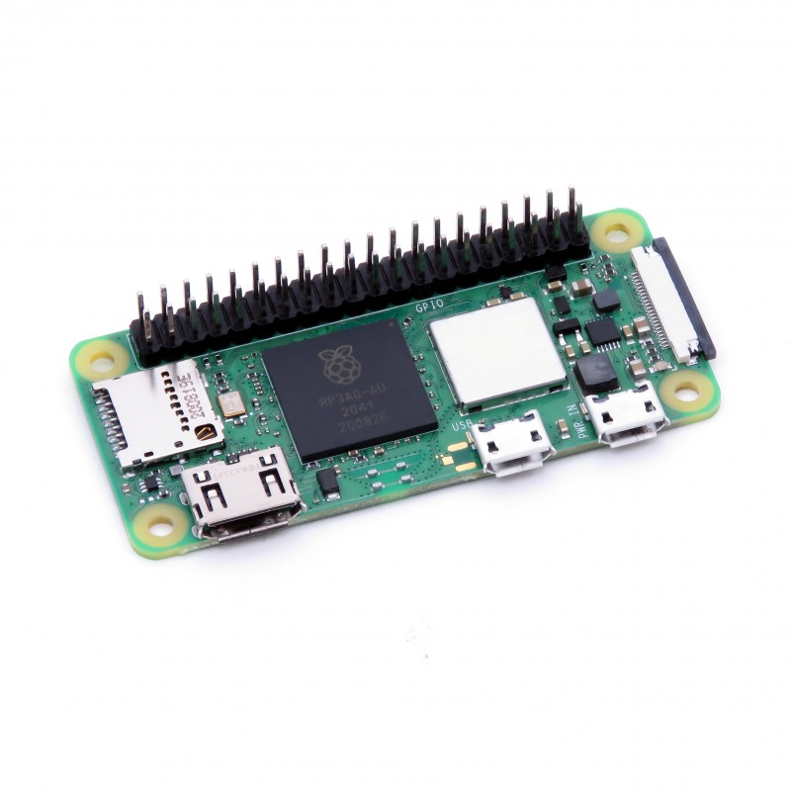
Raspberry pi zero W
This raspberry is used in the project due to its:
lower price,
smaller size
enough computing power

Slide 10
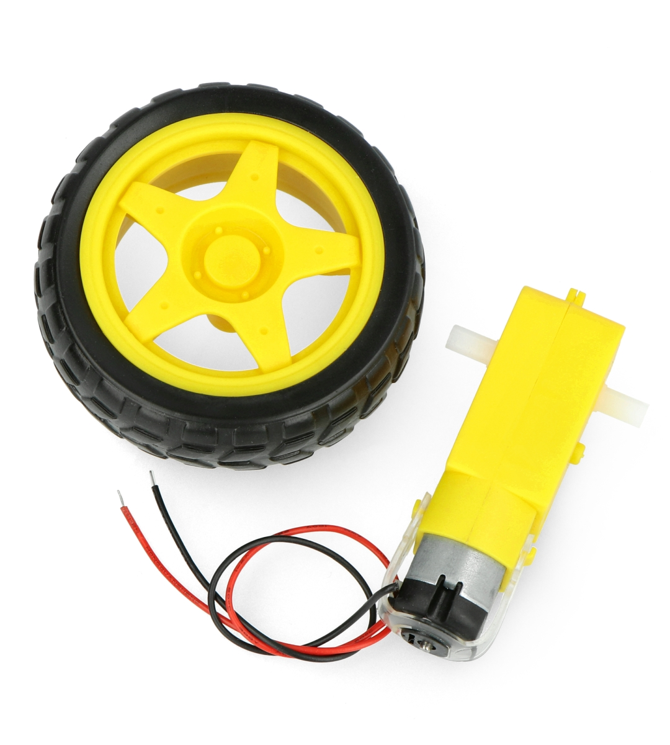
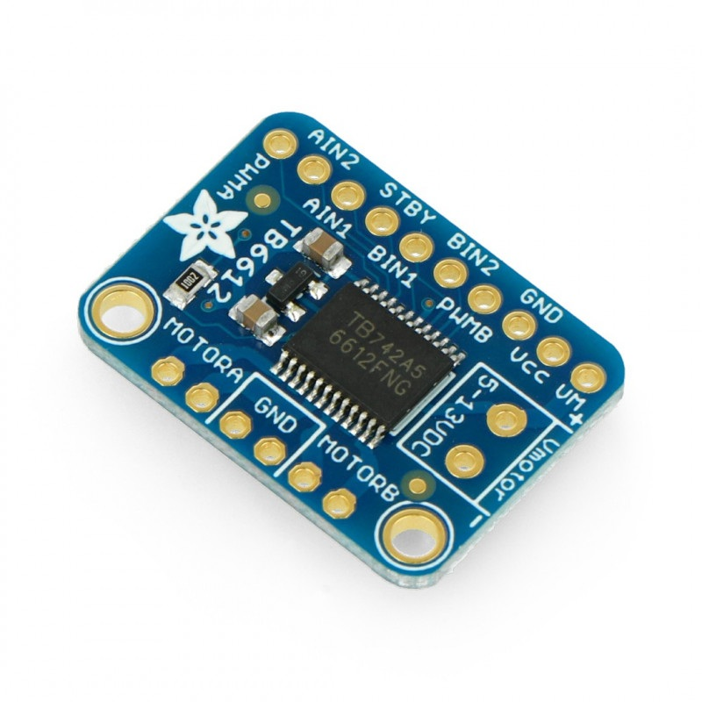
DC Motors and Controller

Slide 11
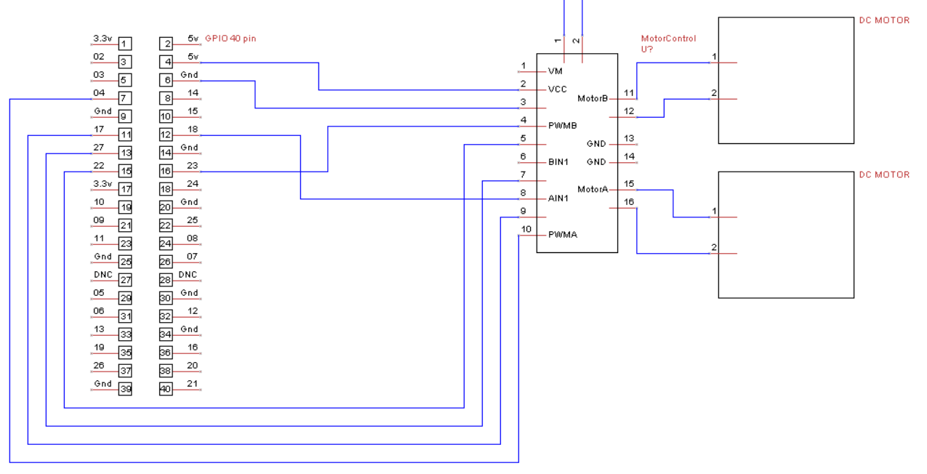
Electrical Schematic for DC motors control

Slide 12
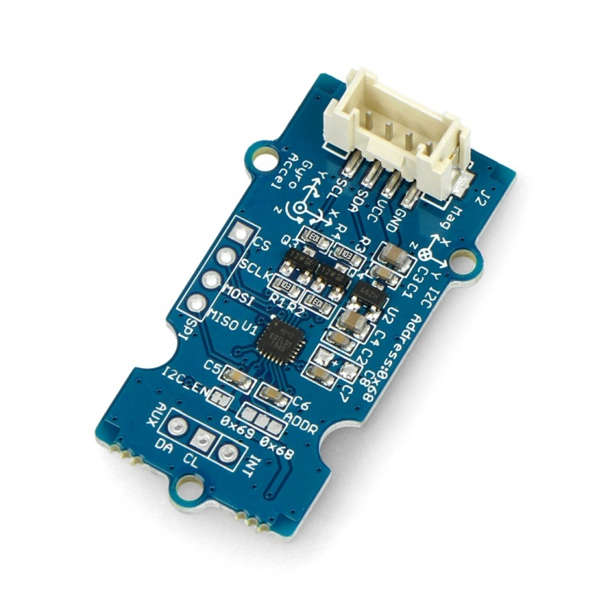
IMU Sensor
This sensor consists of:
3 axis gyroscope
3 axis accelerometer
3 axis magnetometer
Will be used to determine orientation of the robot.

Slide 13
Part 4: Software
Features:
Real time remote control of the robot
Navigation
Simple manual input path planning
Live camera streaming

Slide 14
Control
The whole software is based on communication between the raspberry pi and the computer that is controlling it.
The raspberry works as a server and the computer as a client

Slide 15
Navigation
Is based on the feedback from the imu sensor and encoder in the robot. Values will be sent to the client computer and processed to the coordinates and be shown on the map template.

Slide 16
Path Planning
The program from the computer will allow the user to insert wanted path on the template of the map of the place the robot is in.

